Slide 1

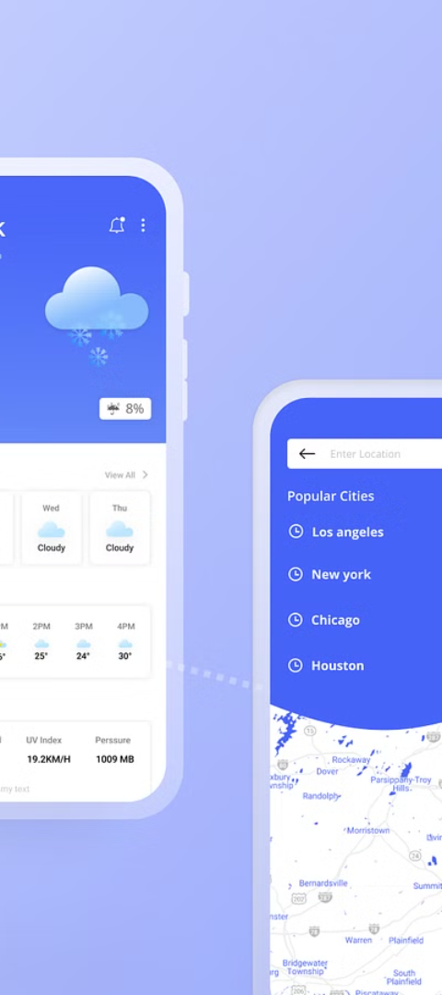

Platform Used
1
iOS
Developed for Apple devices with a focus on user experience and performance.
2
Android
Designed to be compatible with the diverse range of Android devices for seamless functionality.
3
Web
An online platform accessible through web browsers, providing weather updates without requiring a separate app installation.

Slide 2
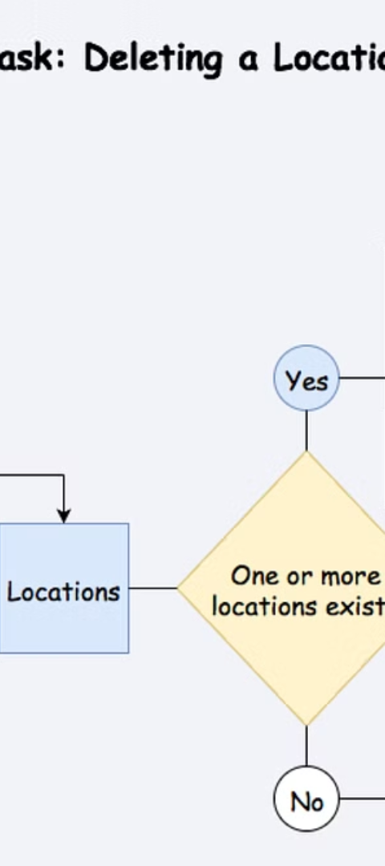



System Flow Diagram
Data Collection
Collects weather data from various sources, including satellites, weather stations, and meteorological organizations.
Processing
Analyzes and processes the data to generate accurate weather forecasts and real-time information.
User Interface
Presents the weather information to the user through an intuitive and easily navigable interface.

Slide 3
Modules
Forecasting
Alerts
Location Services
Utilizes advanced algorithms to predict weather conditions, temperature, and precipitation.
Generates notifications for severe weather conditions to ensure user safety and preparedness.
Utilizes GPS to provide hyper-local weather forecasts and current conditions based on the user's location.

Slide 4
Testing Techniques Used
Testing techniques are essential for ensuring that software applications function correctly and meet specified requirements. Here’s a summary of common testing techniques used in software development:
Manual testing – Involves manual inspection and testing of the software by a human tester.
Automated testing – Involves using software tools to automate the testing process.
Functional testing – Tests the functional requirements of the software to ensure they are met.
Non-functional testing – Tests non-functional requirements such as performance, security, and usability.
Unit testing – Tests individual units or components of the software to ensure they are functioning as intended.
Integration testing – Tests the integration of different components of the software to ensure they work together as a system.
System testing – Tests the complete software system to ensure it meets the specified requirements.
Acceptance testing – Tests the software to ensure it meets the customer’s or end-user’s expectations.
Regression testing – Tests the software after changes or modifications have been made to ensure the changes have not introduced new defects.
Performance testing – Tests the software to determine its performance characteristics such as speed, scalability, and stability.

Slide 5

Conclusion
1
Accuracy
2
Accessibility
The app's accuracy in predicting weather conditions enhances user trust and reliability.
Available on various platforms, enabling users to access weather information anytime, anywhere.
3
User Engagement
Engages users through interactive features and personalized updates based on preferences.

Slide 6



Important Features
Hourly Forecast
Severe Weather Alerts
Daily Forecast
Provides hourly updates on temperature, precipitation, and wind conditions.
Notifies users about severe weather events affecting their location.
Delivers a comprehensive overview of daily weather conditions and temperature trends.

Slide 7
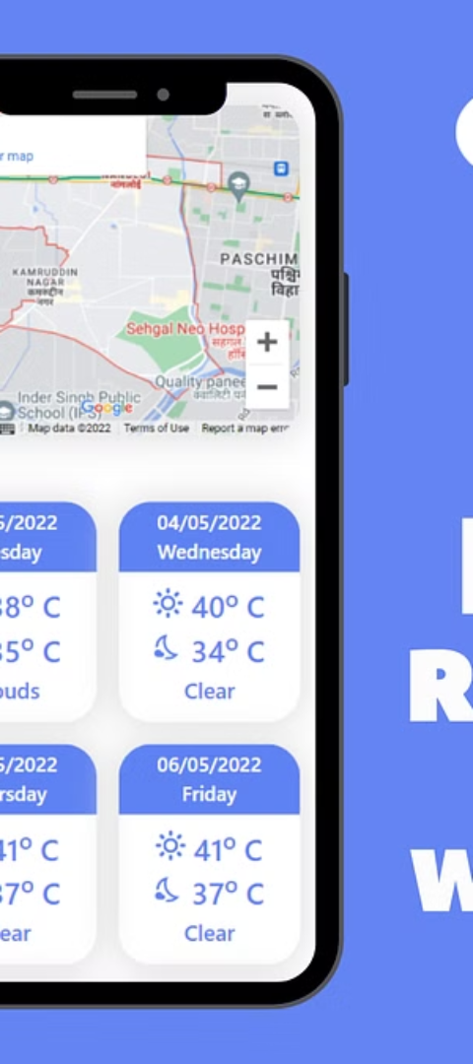
Limitation
Data Dependency
Connectivity
The app's accuracy is dependent on the availability and quality of weather data sources.
Requires a stable internet connection for real-time updates, posing limitations in areas with poor connectivity.
Device Compatibility
May not be compatible with older devices, limiting access for some users.

Slide 8
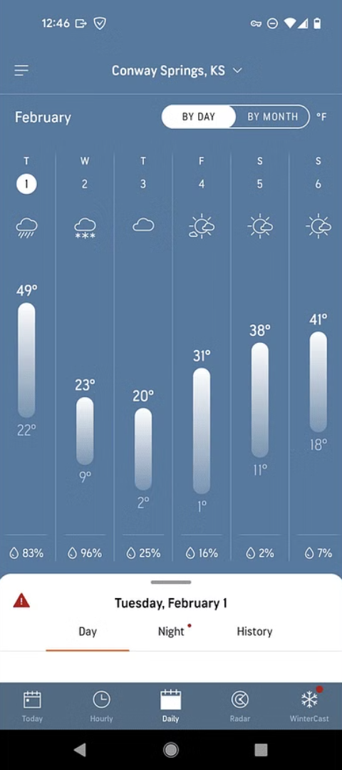
Future Work
1
Advanced Visualization
Implement advanced weather maps and data visualization for an enhanced user experience.
2
Pollution Tracking
Include pollution and air quality tracking to provide comprehensive environmental information.
3
Customization
Introduce customizable widgets and alerts, allowing users to personalize their weather updates.

